Slide 1
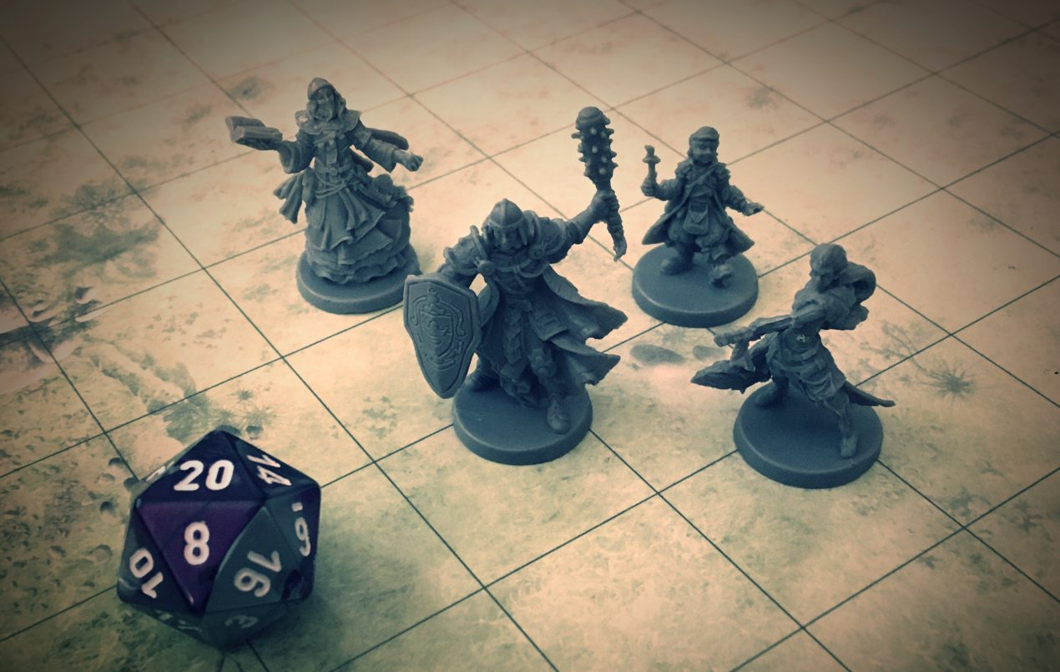
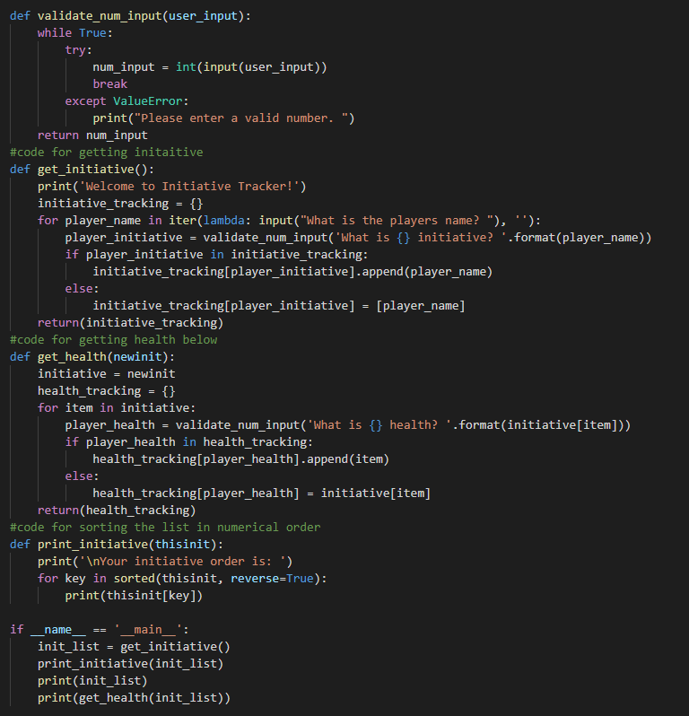
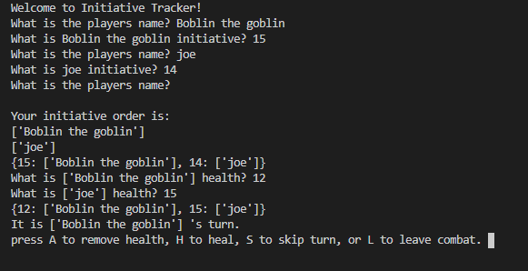
Bring Order to Chaos with
Health_and_Initiative_Tracker
By Nicholas Brownsworth
https://github.com/ksu-is/Health-and-Initiative-Tracker
Helps you keep track of all player’s health and initiative while keeping track of whose turn it is during combat.

